Slide 1
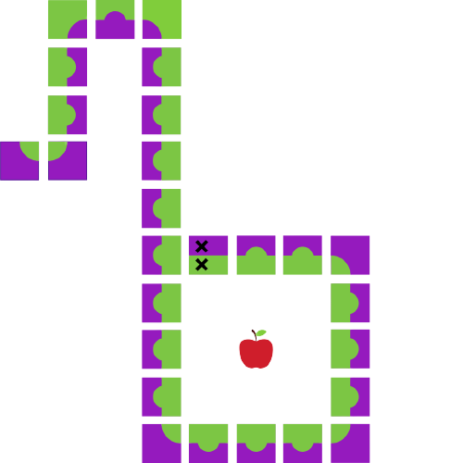
Java Workshop 4
Aadila Ali Sabry

Slide 2
if Statements
Your if statement goes at the beginning, and you can have only one of them for one if block. Your if statement MUST have a boolean expression.
if (boolean expression 1) {
statement (s) ;
} else if (boolean expression 2) {
Different statement (s) ;
} ….
else {
Default statement (s) ;
}
You can have any number of else if statements, even 0. The rules are: they must come before the else statement, and after the if statement. Every else if must have a boolean expression.
Your else statement goes at the end, and it is optional. You may only have one else statement if you have one at all, and it has no boolean expression. Put the default code, ie. the code to execute if none of the conditions hold, here.

Slide 3
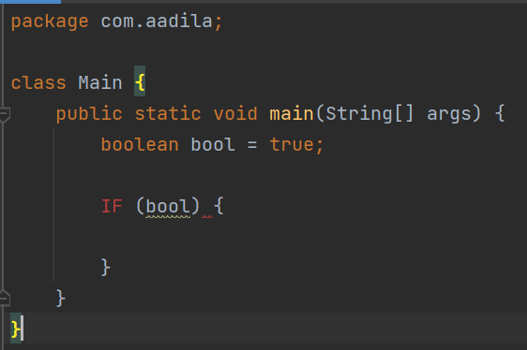

Slide 4
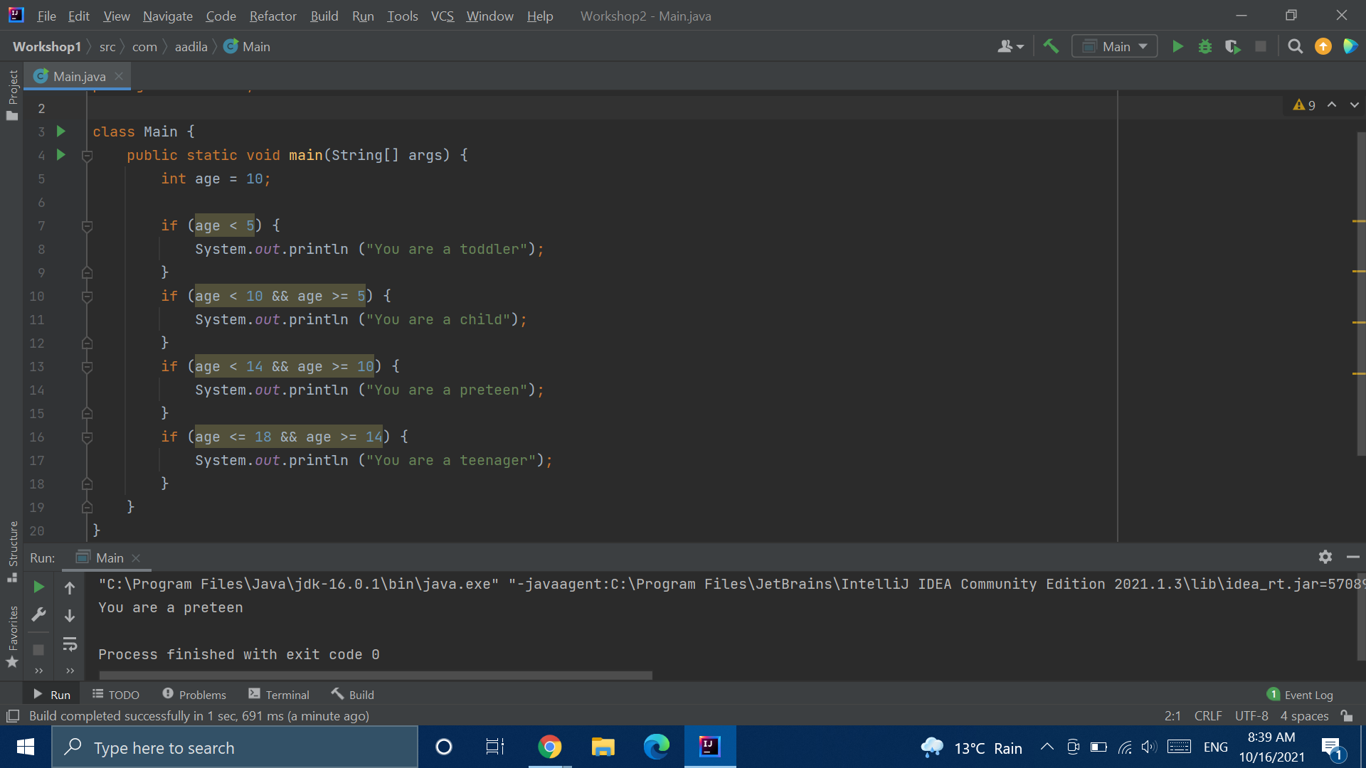

Slide 5
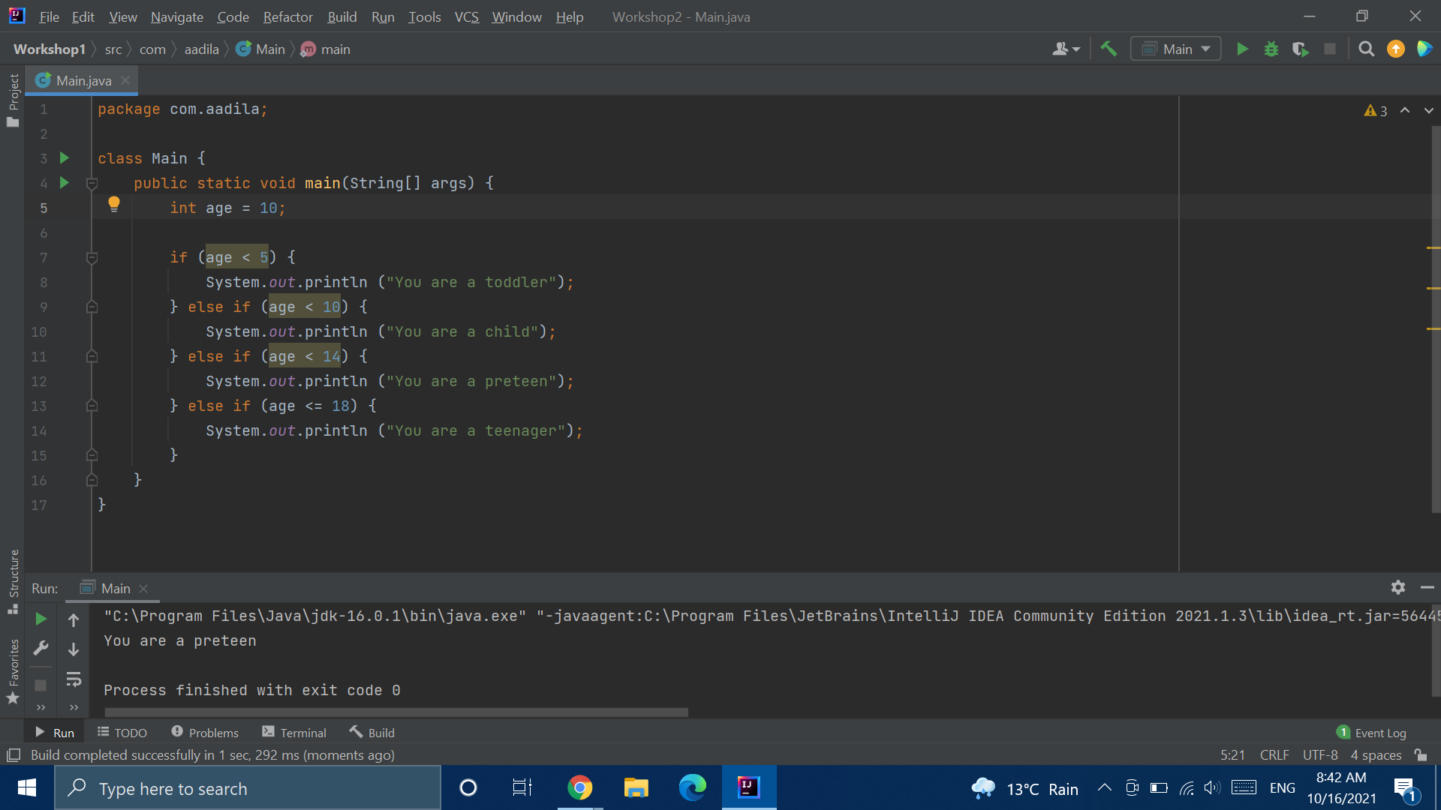

Slide 6
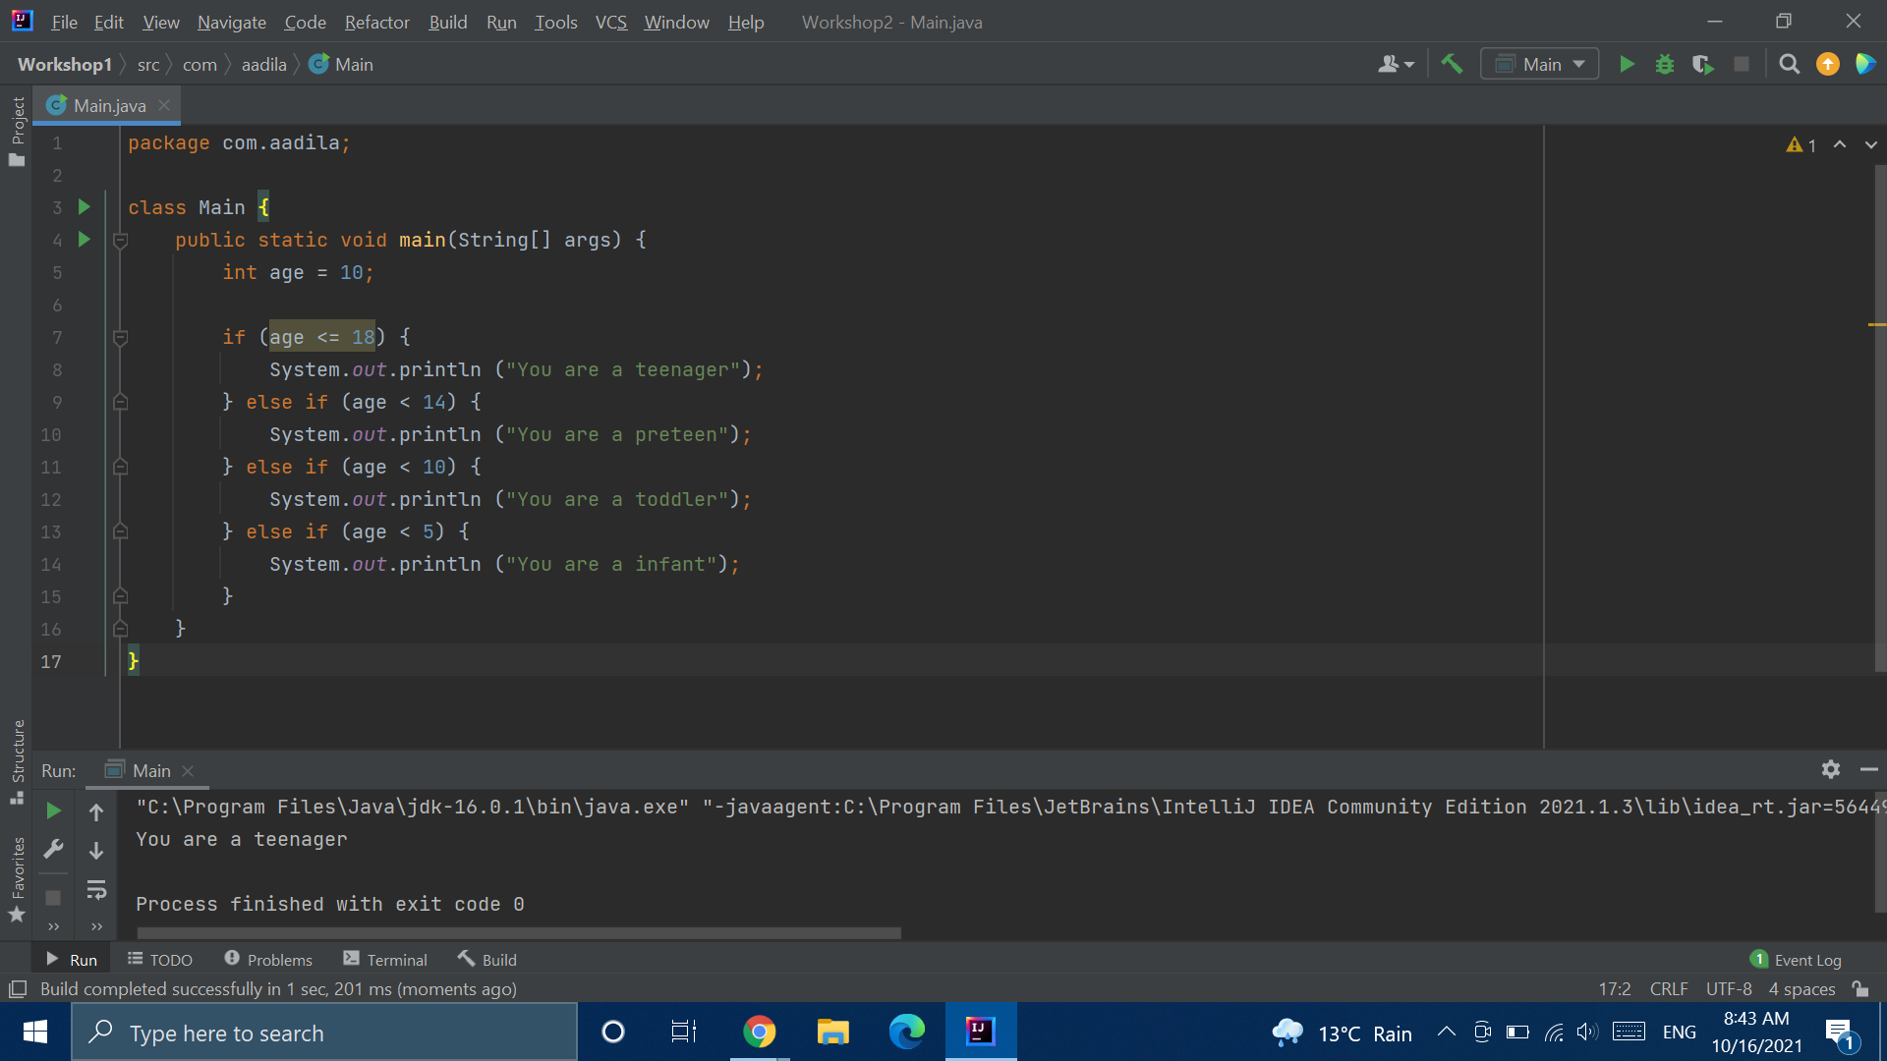
Notes:
https://replit.com/@AadilaAliSabry/Working-with-if-Statements#Main.java

Slide 7
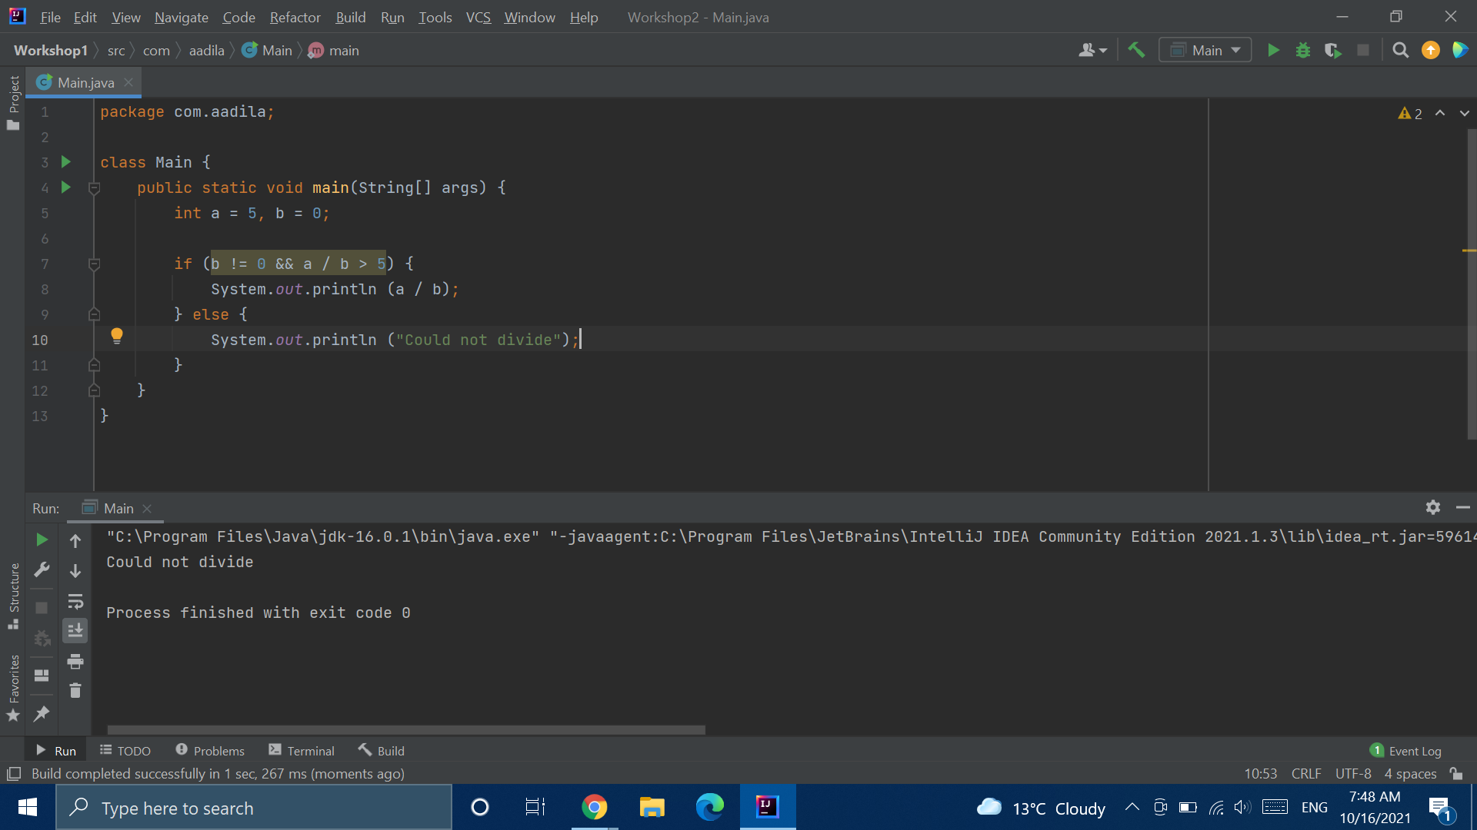

Slide 8
for Loops
for (statement 1; boolean expression; statement 2) {
Statement (s);
}
The boolean expression is evaluated before each time it loops. The for loop will stop once the boolean expression is false
Statement 3 is executed at the end of each loop
Statement 1 is executed once at the beginning of the for loop

Slide 9
for Loops
for (int i = 0; i != 0; i++) {
Statement (s);
}
for (int i = 0; ; i++) {
Statement (s);
}

Slide 10
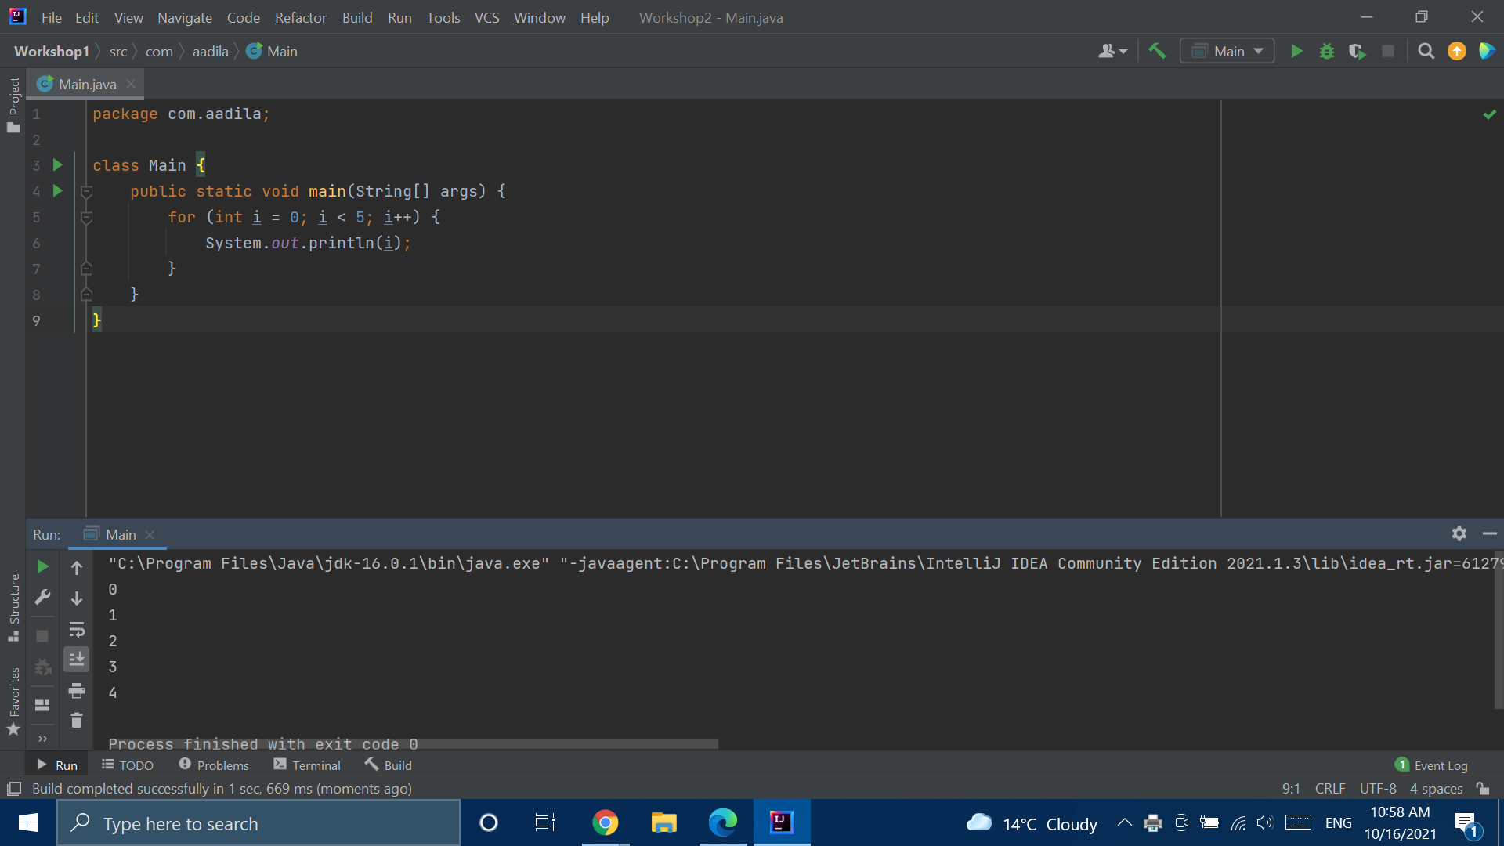

Slide 11
Prime factorization
Notes:
https://www.mathsisfun.com/prime-factorization.html
https://replit.com/@AadilaAliSabry/Prime-Factorization#Main.java

Slide 12
while Statements
while (boolean expression) {
Statement (s);
}
Boolean expression is evaluated before each iteration of the loop

Slide 13
do while Statements
do {
Statement (s);
} while (boolean expression);
Boolean expression is evaluated AFTER each iteration of the loop

Slide 14
Switching between Loops
Notes:
https://replit.com/@AadilaAliSabry/switching-between-Loops#Main.java

Slide 15
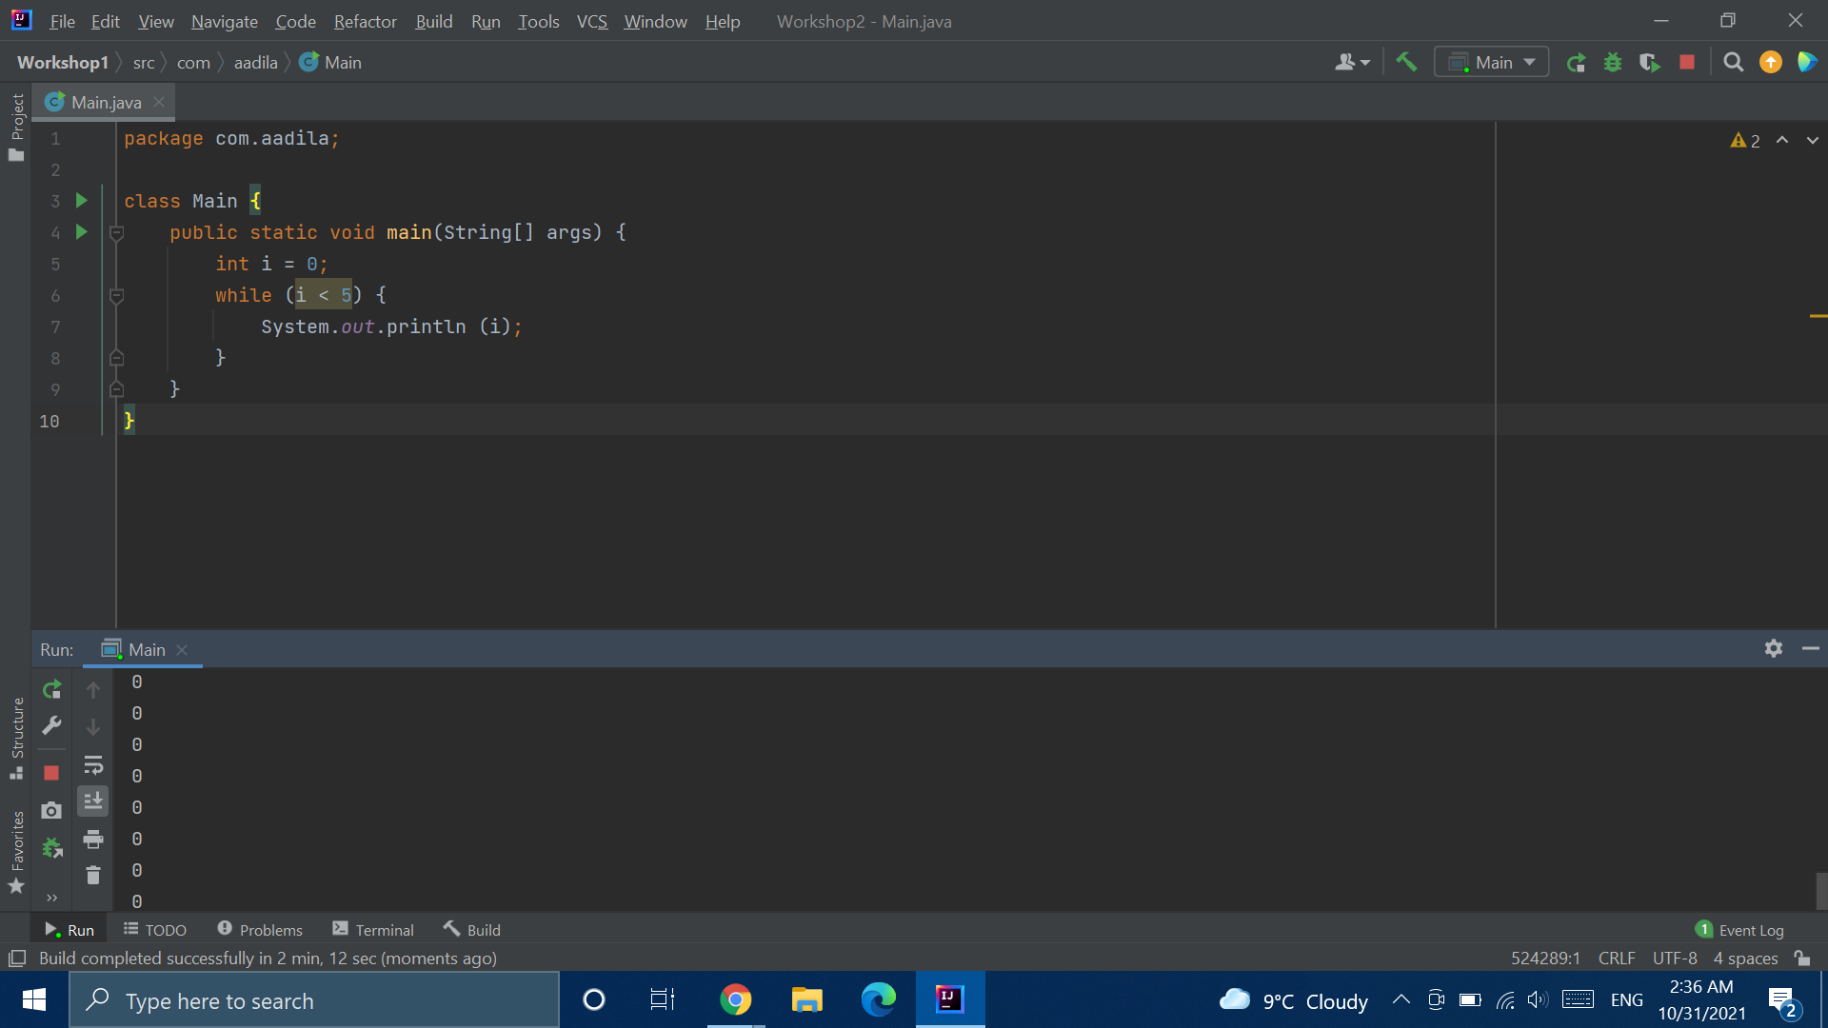

Slide 16
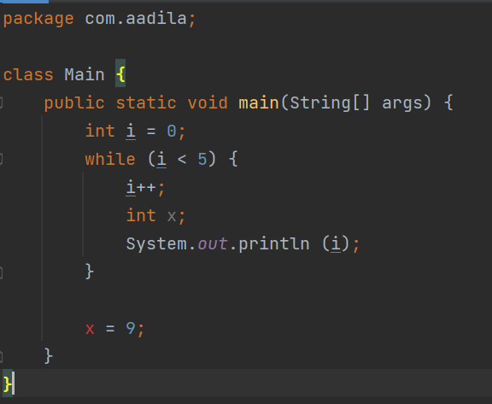
Variable Scope
Notes:
...1
While () {
...Cannot use i here
Int i ;
...2
While () {
…3
Int x;
}
//cannot use x here
…4
}
...5

Slide 17
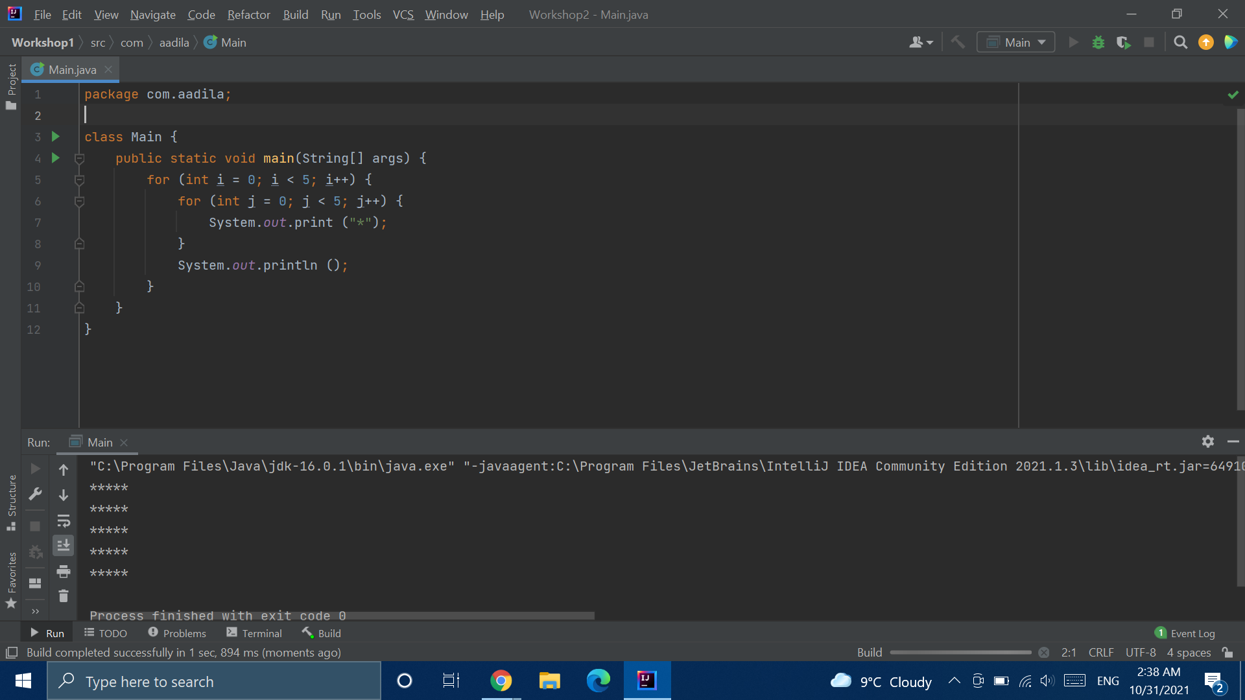

Slide 18
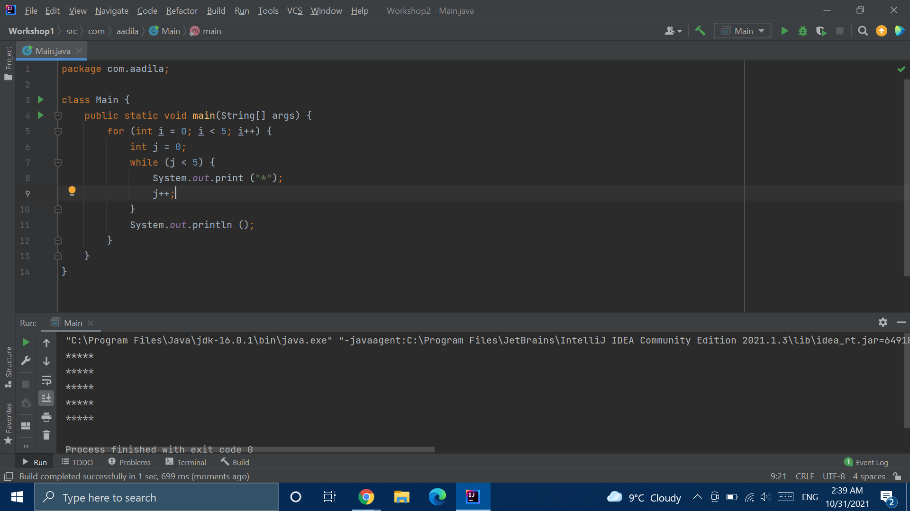

Slide 19
Break Time

Slide 20
Fibonacci Sequence
Notes:
https://www.mathsisfun.com/numbers/fibonacci-sequence.html
https://replit.com/@AadilaAliSabry/Fibonacci-Sequence#Main.java

Slide 21
Christmas Tree
Notes:
https://replit.com/@AadilaAliSabry/Christmas-Tree#Main.java

Slide 22
Guess the Number
Notes:
https://replit.com/@AadilaAliSabry/Number-Guessing-Game#Main.java

Slide 23
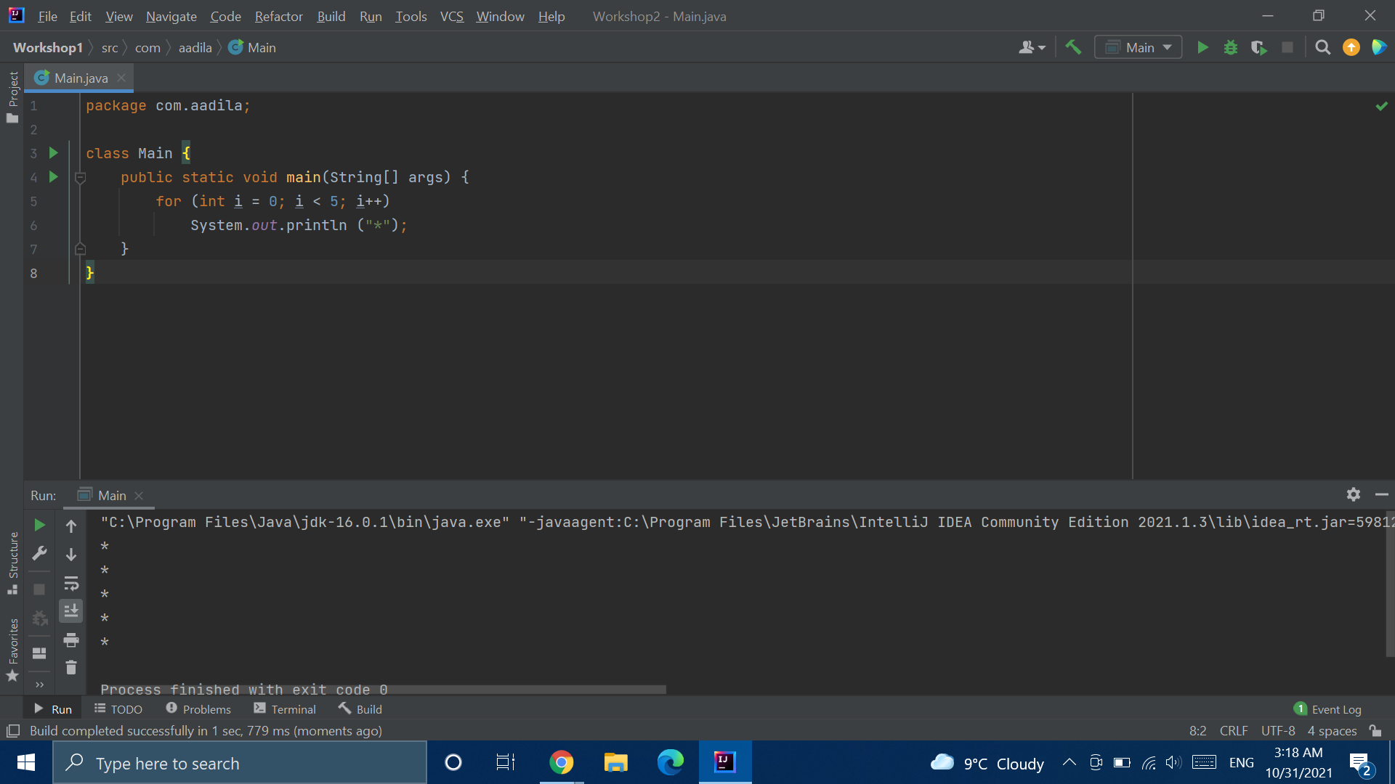

Slide 24
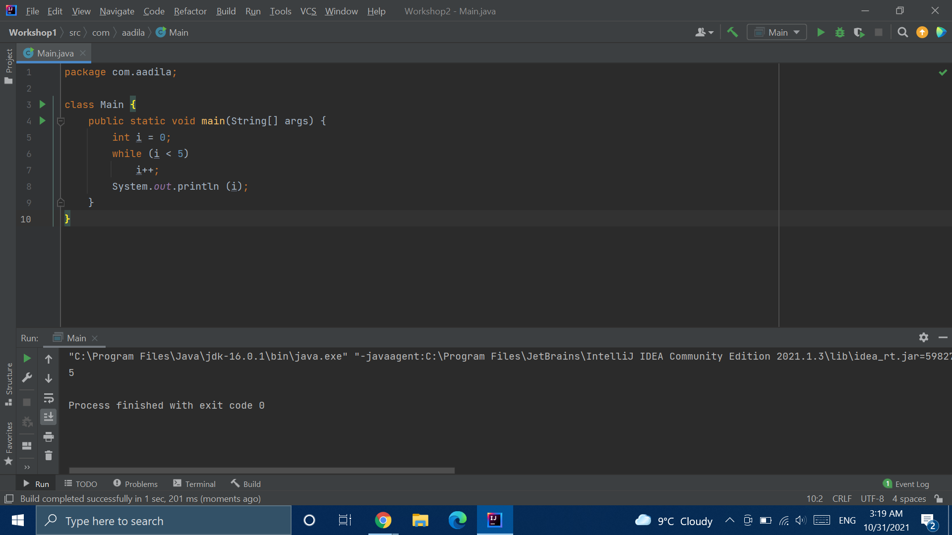

Slide 25


Slide 26


Slide 27


Slide 28
Break Statements
Notes:
https://replit.com/@AadilaAliSabry/Break-Statements#Main.java

Slide 29
Continue Statements
Notes:
https://replit.com/@AadilaAliSabry/Continue-Statements

Slide 30
Prime Checker
Notes:
https://replit.com/@AadilaAliSabry/Primality-Checker#Main.java

